Slide 1
CONSULTATIONS …
Every week:
Kerri: 1-2PM Mondays, room 119, 25 Exhibition walk
Aamir: 2-3PM Wednesdays (except 2 November), room 113, 25 Exhibition walk
Exam period:
Wednesday 2/11/16, 3pm-4pm: 14 Rainforest Walk, room G20
Thursday 3/11/16, 11am-12pm: 14 Rainforest Walk, room G21
Friday 4/11/16, 10am-11am: 14 Rainforest Walk, room G21
Monday 7/11/16, 10am-11am: 14 Rainforest Walk, room G20
Tuesday 8/11/16, 12pm-1pm: 14 Rainforest Walk, room G22
Wednesday 9/11/16, 2pm-3pm: 14 Rainforest Walk, room G22
Thursday 10/11/16, 4pm-5pm: 14 Rainforest Walk, room G20
Friday 11/11/16, 11am-12pm: 14 Rainforest Walk, room G20

Slide 2
FIT1045 Introduction to Algorithms and Programming Lecture 22 Unsolvable Problems
COMMONWEALTH OF AUSTRALIA
Copyright Regulations 1969
WARNING
This material has been reproduced and communicated to you by or on behalf of Monash University pursuant to Part VB of the Copyright Act 1968 (the Act).The material in this communication may be subject to copyright under the Act.Any further reproduction or communication of this material by you may be the subject of copyright protection under the Act.
Do not remove this notice.

Slide 3
Can we find an algorithm to solve every problem on every input?????

Slide 4
Overview
Collatz function
Processes
The Halting Problem
Encoding
Counting
Countable
Cantor Diagonalizable Argument

Slide 5
Collatz function
def collatz(n):
while n > 1:
print(n)
if n % 2 == 0:
n //= 2
else:
n = 3n + 1
print(n)

Slide 6
For the input n=5, the number of integers the following function prints is:
def collatz(n):
while n > 1:
print(n)
if n % 2 == 0:
n //= 2
else:
n = 3n + 1
4
5
6
None of the above.

Slide 7
Question????
Given an integer n as input, will the Collatz function halt?
It has been shown to halt for
n < 19x2⁵⁸ ≅ 5.48x10¹⁸
Will it halt for all inputs?

Slide 8
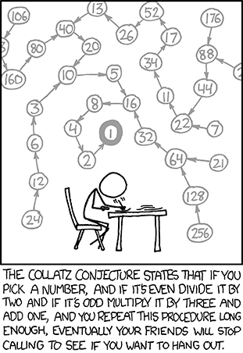
source: xkcd.com

Slide 9
Is Collatz(n) an algorithm?
Yes
No
I do not know
Nobody knows

Slide 10
An Algorithm
A finite sequence of steps for solving a problem with the following properties:
Finiteness
Must always terminate after a finite number of steps.
Definiteness
Each step must be precisely and unambiguously specified.
Input
Zero or more.
Output
One or more.
Effectiveness
Each step is sufficiently basic that they can be done exactly and in a finite length of time.

Slide 11
A Process
Similar to an algorithm but may not terminate.

Slide 12
A Process
A sequence of steps for solving a problem with the following properties:
Definiteness
Each step must be precisely and unambiguously specified.
Input
Zero or more.
Output
One or more.
Effectiveness
Each step is sufficiently basic that they can be done exactly and in a finite length of time.

Slide 13
Error Checking
You need to know whether or not your programs will halt on particular input.
Is it possible to write an algorithm to do this?

Slide 14
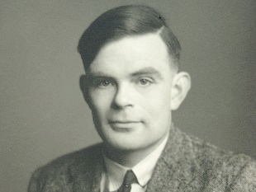
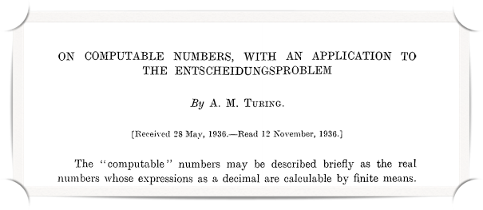
Alan Turing

Slide 15
Halting Problem
Question:
Does there exist an algorithm which can decide for any process P, whether P is an algorithm?

Slide 16
Halting Problem
Suppose there is an algorithm to answer this question …

Slide 17
Halting Problem
The Plan:
Represent program/process P as a number N Input: process P and number N Question: does P halt on input N?

Slide 18
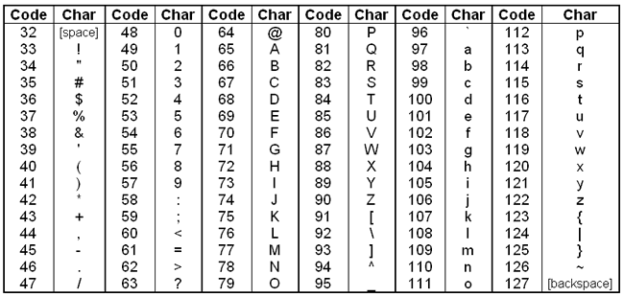
ASCII Table
ASCII Table from: http://macao.communications.museum/

Slide 19
Collatz function
def collatz(n):
while n > 1:
print(n)
if n % 2 == 0:
n //= 2
else:
n = 3n + 1
print(n)

Slide 20
Coding Collatz function
def collatz(n):
while n > 1:
print(n)
if n % 2 == 0:
n //= 2
else:
n = 3n + 1
print(n)
100 101 102 32 99 111 108 108 97 116 122 40 110 41 58 10
32 32 32 32 119 104 105 108 101 32 110 32 62 32 49 58 10
32 32 32 32 32 32 32 32 112 114 105 110 116 40 110 41 10
10
32 32 32 32 32 32 32 32 105 102 32 110 32 37 32 50 32 61 61 32 48 58 10
32 32 32 32 32 32 32 32 32 32 32 32 110 32 47 47 61 32 50 10
32 32 32 32 32 32 32 32 101 108 115 101 58 10
32 32 32 32 32 32 32 32 32 32 32 32 110 32 61 32 51 42 110 32 43 32 49 10
10
32 32 32 32 112 114 105 110 116 40 110 41 10
ASCII Table from: http://macao.communications.museum/

Slide 21
Representing a sequence of integers
100 101 102 32 99 111 108 108 97 116 122 40 110 41 58 10
32 32 32 32 119 104 105 108 101 32 110 32 62 32 49 58 10
32 32 32 32 32 32 32 32 112 114 105 110 116 40 110 41 10
10
32 32 32 32 32 32 32 32 105 102 32 110 32 37 32 50 32 61 61 32 48 58 10
32 32 32 32 32 32 32 32 32 32 32 32 110 32 47 47 61 32 50 10
32 32 32 32 32 32 32 32 101 108 115 101 58 10
32 32 32 32 32 32 32 32 32 32 32 32 110 32 61 32 51 42 110 32 43 32 49 10
10
32 32 32 32 112 114 105 110 116 40 110 41 10
Change sequence into a number
100 + 101*128¹+102*128² + 32*128³+…
So we could write a function:
which takes a function and returns a number representing it.
def function_to_num(functionName)

Slide 22
Conversion functions
So we could write a function which takes a function and returns a number representing it.
We could also write a function that takes a number and returns the function it represents, or None otherwise.
def function_to_num(function)
def num_to_function(function)

Slide 23
Let Us Now Assume … (in order to obtain a contradiction)
There exists an algorithm which solves the Halting Problem

Slide 24
Halting Function
So we could write a function:
which takes a function and a number, k, and:
returns True if function(k) halts, and
False otherwise.
def halt (function, k)

Slide 25
Now to show there is no algorithm for the function halt, we need another function …
Devious

Slide 26
Devious function
def devious(n):
process = num_to_function(n)
if process != None:
if halt(process, n):
while True:
pass
else:
return True

Slide 27
Devious Question
devious(function_to_num(devious)) = ?

Slide 28
Halting Problem
halts for any input
True if p(n) halts
halt(p, n) =
False if p(n) does not halt
a process
True if p(<p>) does not halt
devious(<p>) =
Loop forever if p(<p>) halts
Number representing process p
devious(<devious>) = ?

Slide 29
devious(<devious>) = ?
halts for any input
True if p(n) halts
halt(p, n) =
False if p(n) does not halt
a process
True if p(<p>) does not halt
devious(<p>) =
Loop forever if p(<p>) halts
Number representing process p
True
Loops forever
Can’t be defined

Slide 30
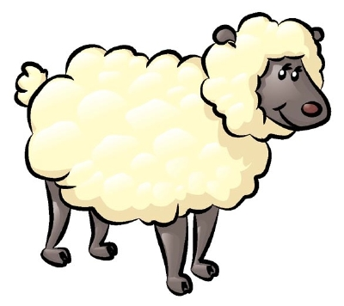
Counting
1
2
3
4
5
6
7

Slide 31
Countable Sets
Positive Even Numbers
2
4
6
8
10
12
14
16
18
…
1
2
3
4
5
6
7
8
9
…
Any set we can count using all the positive integers is said to be countable

Slide 32
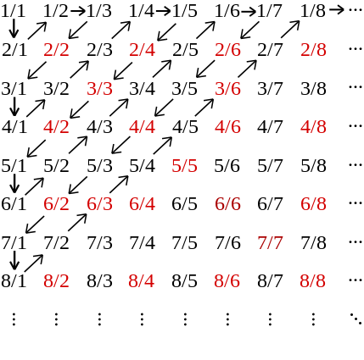
Positive Fractions

Slide 33
1
0.212345698121...
2
0.321234112312...
Suppose we have an enumerated list of
all the real numbers
3
0.313341231212...
4
0.212121212121...
...

Slide 34
1
0.212345698121...
Suppose we have an enumerated list of
all the real numbers.
We find a number not in the list.
2
0.321234112312...
3
0.313341231212...
4
0.212121212121...
5
0.213111212121...
...
k
0._ _ _ _ _ _ _ _ _
0.22311...
0.13122...
Number 0.13122… is not in the list!
It differs at position k with the number at position k in the list (for all k).

Slide 35
Uncomputable Numbers
There are only a countable number of algorithms.
However, there are uncountable number of real numbers.
So, some real numbers cannot be computable.
However, I cannot tell you which ones.
Notes:
Each function maps to a number (bits – integer) so we don’t have enough turing machines to have one for each real number

Slide 36
Thank You

